Slide 1




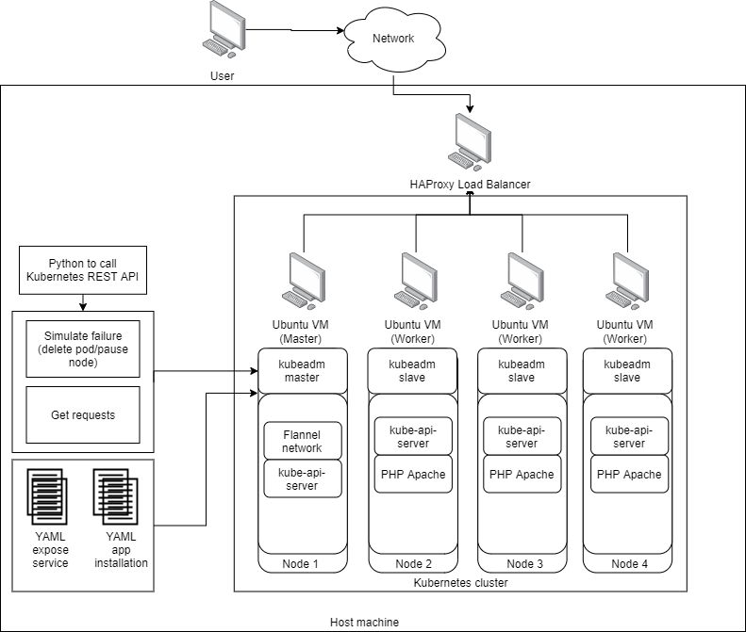












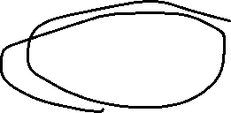





This website seems stable to surf, wow!
AUTO SCALING AND LOAD BALANCING WITH HIGH AVAILABILITY SERVER USING KUBERNETES
CHAI YIOW YANG
ASSOC. PROF. DR ANG TAN FONG
High availability (HA) and high scalability of pods (PHP server pod)
Self-provisioned external load balancer (LB) and node health check
Traffic load distribution
Auto scale and self recovery pods
Maintains web server uptime

